Slide 1
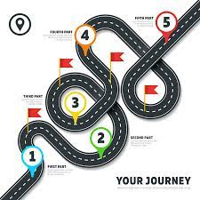
French Learning Journey
Year 7
Summer 2: Unit 6
Mes vacances – using the near future
Cultural focus – Tour de France
Revision for end of year exam
At the café – ordering snacks and drink
Assessment 4 Listening and reading
ARE speaking
Spring 2: Unit 4
School life
Expanding opinions
Telling the time
Regular verbs in the present tense
Using connectives
Comparing school in UK and France
Move to
Year 8
Summer 1: Unit 5
Ma zone- talking about my area
Using il y a and il n’y a pas de
Using descriptive writing
Understanding directions
Year 7 steps to success
1. Learn and revise vocabulary carefully approximately 10 words a week.
2. Sign up to www.quizlet.com/ join your teacher’s group to support your learning – also try linguascope and wordreference.
3.Create mini flashcards of vocabulary to help your learning throughout he year on each topic, set of key words.
4. Set achievable goals and try your best to work towards them.
Assessment 3 Listening and reading
Mini speaking assessment
Spring 1: Unit 3
Describing family and friends
Using adjectives
Using qualifiers
Assessment 5
Listening, reading and writing
Assessment 2
Listening and reading
writing
Autumn 1 Unit 1
Introductions and greetings
Essential phonics
Definite and indefinite articles
Likes and dislikes
Autumn 2: Unit 2
Introduction to hobbies and freetime
Using jouer and faire
Present tense regular er verbs
Weather expressions
Time expressions
Christmas in France
Skills Focus
1. Vocabulary – to build a sound knowledge base through listening, speaking, reading and writing.
2. Pronunciation – to develop an understanding of French phonics
3. Grammar – to understand how to construct and adapt language for my own purposes
Assessment 1
Je me présente - speaking assessment
Listening assessment

