Slide 1
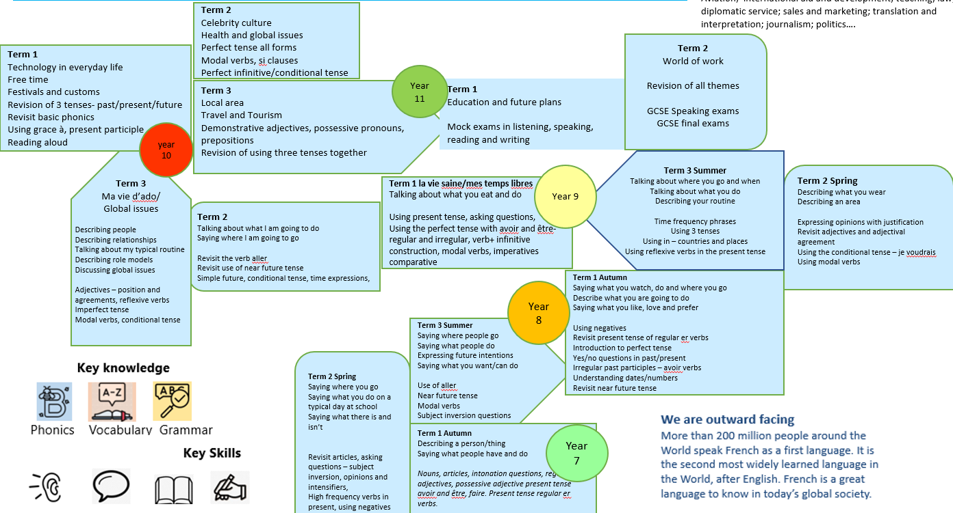
Kingstone Academy Trust: MFL Faculty Curriculum Map: French
Our Intent – What we aim to do?
We aim to empower our students with the tools for lifelong language learning, through the teaching of phonics, vocabulary and grammar. We also strive to develop an appreciation of the culture of the countries where French is spoken.
What skills and cultural capital do our students gain?
Through exposure to different culture we challenge the misconception that British people don’t need languages.
Students learn how widely spoke French is and explore the similarities between life in the UK and in France.
How is the curriculum designed?
The MFL curriculum is built around the the core principles of phonics, vocabulary and grammar. In years 7-9 we introduce key grammatical ideas that students need to help construct language for their own purposes. These are revisited several times throughout the curriculum from year 7 to 11 so that each a grammar feature is revisited, students’ knowledge deepens. For example the perfect tense is introduced in Year 8 unit 1, again in Year 8 unit 3 and then revisited in year 9, 10 and 11 with increasing complexity.
What content is covered and how is this delivered over time?
We are currently moving away from a topic led curriculum and moving towards a grammar led approach. Grammar points are introduced at specific stages based on complexity and frequency.
The point at which the grammar is introduced should enable the student to manipulate the language for their own purposes and build confidence in their communication skills.
Lessons within the MFL Faculty are delivered using Rosenshine’s principles of learning as the basis for our instruction. In particular the use of the ADAPT technique focussing on modelling, scaffolding and retrieval strategies. The reasoning and ideas behind these principles make up the key elements of our teaching on a daily basis.
The vocabulary selected for each unit of learning is based on how useful it will be in terms of frequency but also how well it brings to life the main grammar focus of the lesson. Lessons will always include a range of phonics, vocabulary and grammar instruction. Teachers will deepen the students understanding through different methods of practice.
Retrieval practice is a feature of every lesson through the use of a retrieval starter task or a range of do it now activities aimed at securing the retention of core knowledge. Points of grammar, phonics and vocabulary are revisited throughout the curriculum, so that knowledge is embedded and students are able to apply it to a range of contexts.
Blended learning
Independent learning is essential whilst learning a language. Blended learning should be set weekly when relevant to support in class teaching. Task include a vocabulary learning task – to cover the 2000 most frequently used words in the target language and retrieval tasks to embed grammar.
Curriculum overview years 7-11

Slide 2



Kingstone Academy Trust: MFL Faculty Curriculum Map: French
Future careers in French.
Aviation; international aid and development; teaching; law; diplomatic service; sales and marketing; translation and interpretation; journalism; politics….
Term 2
Health and global issues
Perfect tense all forms
Modal verbs, si clauses
Perfect infinitive/conditional tense
Term 2
World of work
Revision of all themes
GCSE Speaking exams
GCSE final exams
Term 1
Technology in everyday life
Free time
Festivals and customs/ celebrity culture
Revision of 3 tenses- past/present/future
Revisit basic phonics
Using grace à, present participle
Reading aloud
Year 11
Term 3
Local area
Travel and Tourism
Demonstrative adjectives, possessive pronouns, prepositions
Revision of using three tenses together
Term 1
Education and future plans
Mock exams in listening, speaking, reading and writing
year 10
Term 2
Talking about what I am going to do
Saying where I am going to go
Revisit the verb aller
Revisit use of near future tense
Simple future, conditional tense, time expressions,
Term 3 Summer
Talking about where you go and when
Talking about what you do
Describing your routine
Time frequency phrases
Using 3 tenses
Using in – countries and places
Using reflexive verbs in the present tense
Year 9
Term 2 Spring
Describing what you wear
Describing an area
Expressing opinions with justification
Revisit adjectives and adjectival agreement
Using the conditional tense – je voudrais
Using modal verbs
Term 3
Ma vie d’ado/
Global issues
Describing people
Describing relationships
Talking about my typical routine
Describing role models
Discussing global issues
Adjectives – position and agreements, reflexive verbs
Imperfect tense
Modal verbs, conditional tense
Term 1 la vie saine/mes temps libres
Talking about what you eat and do
Using present tense, asking questions,
Using the perfect tense with avoir and être- regular and irregular, verb+ infinitive construction, modal verbs, imperatives
comparative
Year 8
Term 1 Autumn
Saying what you watch, do and where you go
Describe what you are going to do
Saying what you like, love and prefer
Using negatives
Revisit present tense of regular er verbs
Introduction to perfect tense
Yes/no questions in past/present
Irregular past participles – avoir verbs
Understanding dates/numbers
Revisit near future tense
Term 3 Summer
Saying where people go
Saying what people do
Expressing future intentions
Saying what you want/can do
Use of aller
Near future tense
Modal verbs
Subject inversion questions
Term 2 Spring
Saying where you go
Saying what you do on a typical day at school
Saying what there is and isn’t
Revisit articles, asking questions – subject inversion, opinions and intensifiers,
High frequency verbs in present, using negatives
Term 1 Autumn
Describing a person/thing
Saying what people have and do
Nouns, articles, intonation questions, regular adjectives, possessive adjective present tense avoir and être, faire. Present tense regular er verbs.
Year 7

Slide 3


Year 7 Autumn Term 1 Key knowledge Describing a person/thing Saying what people have and do Key Questions Qu’est-ce que c’est? Tu est comment? Tu es de quelle nationalité? As-tu des frères et des soeurs? As-tu un animal? Qu’est-ce que tu fais? Vocabulary focus Recognition How to learn vocabulary Pronunciation Spelling Using word in a sentence Reading focus Sept couleurs magiques – poem Writing focus – wanted/missing poster Speaking – KQ conversation | Grammar Avoir and être 1st/2nd/3rd person sing Using c’est Numbers 1-31 Definite articles – le/la/l’/les Using faire Adjectival agreement Plural nouns – x/s Yes and no questions – raised intonation | Ssc – sound symbol correspondence Ai/oi Ch/ç/soft c Qu/j/soft g Tion/ien SFC Revisit a/i | Blended learning Mixed word vocab lists to learn – 10 words per week High frequency vocab relevant to context | SMSC links British values Respect Cultural differences greetings
Big Picture
Understanding what makes you who you are as a person.
Learning basic structures that will be used until GCSE to introduce and describe yourself and others

Slide 4


Year 7 Autumn Term 2 Key knowledge Saying what people do people do and play Saying what people play and do Key Questions Tu es sportif(ve)? Tu aimes le sport? Que fais tu quand il fait beau? Qu’est-ce que tu aimes ? Vocabulary focus Recognition How to learn vocabulary Pronunciation Spelling Using word in a sentence Deepening vocabulary through a challenging text Reading focus Writing focus- describing a picture Speaking – questions, questions, questions paired speaking | Grammar Asking and answering basic questions Inversion questions – aimes - tu? Intonation to ask questions Using opinion verbs Simple connectives Using jouer à/ faire de Using faire Using regular er verbs to say what you do 1st/2nd/3rd person. Develop a lexicon of regular er verbs Using 2 verb structures – aimer + inf | Ssc – sound symbol correspondence SFC – silent final consonant a i eu e/ au/eau/o u/ou SF E/ é/et/er en/an/on ain/in/è/ ê Liason t/s | Blended learning Mixed word vocab lists to learn – 10 words per week High frequency vocab relevant to context | SMSC links Cultural differences Christmas in France -
Big Picture
Learning how to express likes and dislikes
Key structures that will be used each year until GCSE
Learning how to take part in simple conversations

Slide 5
Year 7 Spring Term 1 and 2 Key knowledge Saying what people do people do and play Saying what people do Describing your routine On a school day Key Questions Tu aimes tes matières? Quelle heure est-il? Ta journée est comment? Reading focus – extract from le petit Nicolas – first day at school Writing focus- describing your day storyboard Speaking – reading aloud Key questions conversation | Grammar Asking and answering basic questions Inversion questions – aimes - tu? Intonation to ask questions Using opinion verbs Simple connectives and intensifiers Telling the time Using basic negatives Using regular er verbs to say what you do 1st/2nd/3rd person. Develop a lexicon of regular er verbs Use a year 7 version of avocado sheet to support writing | Ssc – sound symbol correspondence Ç In Oi Â SFE | Blended learning Mixed word vocab lists to learn – 10 words per week High frequency vocab relevant to context | SMSC links Differences in school life Create a French page for our website-
Big picture
A students school day forms a major part of their life between the ages 5-16.
Students learn the key structures and grammar to be able to discuss their day and use prior learning to give opinions about what they do/learn.

Slide 6
Year 7 Summer Term 1 Key knowledge Saying what people do people do and play Saying what there is and isn’t Saying what you can and cannot do Key Questions Qu’est-ce qu’il ya dans ta ville? Comment est ta ville? Qu’est-ce qu’on peut faire? Où vas –tu le weekend? Reading focus Writing focus- Où j’habite – written presentation Speaking – describing a photo Key questions conversation | Grammar Asking and answering basic questions Inversion questions – Il y a un/une Intonation to ask questions Using opinion verbs Simple connectives and intensifiers Using basic negatives Using modal verb + infinitive Use a year 7 version of avocado sheet to support writing | Ssc – sound symbol correspondence Oi i É Silent final e SFC | Blended learning Mixed word vocab lists to learn – 10 words per week High frequency vocab relevant to context | SMSC links Looking at towns in France Easter in France – cultural work British values respecting other people and their opinions
Big Picture
Being able to discuss your area
Where it is in the country, and your opinion of what it is like
Looking at areas of France to develop geographical knowledge of the TL country.
A basic knowledge of what different regions of France are like

Slide 7
Year 7 Summer Term 2 Key knowledge Saying what people do people do and play Saying where you go – places , countries Saying what you are going to do Key Questions Où vas – tu? Comment voyages – tu? Quand vas-tu? Qu’est-ce que tu vas faire? Reading focus – holiday regions of France Writing focus - Mes vacances – extended writing task Speaking – reading aloud Key questions conversation | Grammar Asking and answering basic questions Question words Comment Où Quand? Saying to/in – en/à Using the near future tense Aller 1st/2nd/3rd person Use a year 7 version of avocado sheet to support writing | Ssc – sound symbol correspondence Ou SFE é/er/et En/an/on | Blended learning Mixed word vocab lists to learn – 10 words per week High frequency vocab relevant to context | SMSC links Regions of France Tour de France – cultural work
Big picture
Understanding where places are in the world
Understanding the concept of Francophone countries what they are and where they are.

Slide 8
Year 7 Summer Term 2 Key knowledge Saying what people do people do and play Saying what you eat and drink and why Discussing mealtimes Making invitations Ordering drinks and snacks Key Questions Qu’est-ce que tu aimes manger et boire? Qu’est-ce que tu n’aimes pas? Pourquoi? Quel est ton plat préferé? Tu veux aller au café? Qu’est-ce que tu vas faire? Vous désirez? Reading focus – Bastille Day Le déjeuner du matin poem Writing focus – making an invitation Describing a picture Speaking – Key questions conversation | Grammar Asking and answering basic questions Extended opinions with reasons Using larger numbers Connectives and intensifiers Revisit near future tense Revisit essential verbs Use of verb vouloir – 1st/2nd/3rd person Use a year 7 version of avocado sheet to support writing | Ssc – sound symbol correspondence Eu/eau Oi Ui SFC In É ou | Blended learning Mixed word vocab lists to learn – 10 words per week High frequency vocab relevant to context Deepening vocabulary knowledge | SMSC links Bastille Day Social conventions British values - respect
Big Picture
Using extended opinions introduced earlier in year 7
Start to build up a bank of questions and answers that can be used in GCSE level conversations
Learn about social conventions when eating out/ ordering food in France

Slide 9
Year 8 Autumn Term 1 Key knowledge Saying what people d Expressing how you feel Saying what you do and where you go? Saying what you don’t do and why Talking about what you have done. Key questions Qu’est-ce que tu regardes? Tu aimes aller au cinema? Que fais tu quand tu es connecté? Film Study – monstre à Paris Reading: Tintin – extract from graphic novel One short story study lesson from either spy/gothic genre Speaking –key questions Writing – Hier soir – extended writing using two tenses | Grammar Present tense of regular verbs: regarder aimer détester préférer Present tense aller/faire Aller + infinitive Negatives - extend Present and perfect Yes/No questions in two tenses Irregular past participles Use a year 8 version of avocado sheet to support writing | Ssc – sound symbol correspondence Revisit eu Closed o Open 0 S Soft ç Gn j/soft g Th Que | Blended learning Revisit year 7 vocabulary for first two weeks Deepening vocabulary knowledge | SMSC links Internet safety Cultural links – French cinema/ literature
Big picture
Looking at popular culture
Understanding how music and film preferences vary in France to those in our country
Introduction to French cinema and literature

Slide 10
Year 8 Autumn Term 2 Key knowledge Saying what people do people do and play Saying what you celebrate Saying how you celebrate Describing when you celebrate Key questions Tu aimes les fêtes? Tu vas au carnaval? Quelle est ta fête préféré? Tu vas au marché de Noël Listening – transcription and dictation task once a week Reading – short story study from year 8 reading pack Speaking – ma fête préférée – presentation Reading aloud passage Writing – je vais au marché de Noël Describing a picture | Grammar Understanding dates, numbers and months Using opinions to express likes and dislikes Describing an event Present tense of er, ir and re verbs Using the near future tense Aller + infinitive | Ssc – sound symbol correspondence Nasals In/é SFC er endings | Blended learning Mixed word vocab lists to learn – 10 - 15 words per week High frequency vocab relevant to context Deepening vocabulary knowledge | SMSC links Christmas in France British Values – respect for different cultures and religions
Big picture
Understanding different celebrations and festival from the TL country
Staring to learn the basic structures and vocabulary needed to talk about festivals in different time frames in line with GCSE unit 5 theme 2 Popular culture

Slide 11
Year 8 Spring Term 1 Key knowledge Saying what people do people do and play Describing colours and styles of clothing Saying what you would like to do and wear Describing your routine Key Questions Qu’est-ce que tu portes? Qu’est-ce que tu aimes porter et pourquoi? Comment est ta journée Comment est ton uniforme? Qu’est-ce que tu voudrais porter? Reading Continue with reading focus – Tintin or short stories pack for year 8 | Grammar Revisit adjectives Adjectival agreement Extended opinions Using three tenses Basic perfect/near future Conditional using je voudrais Using modal verbs to say what you have to do Using reflexibve verbs in the present tense to describe your routine Use a year 8 version of avocado sheet to support writing | Ssc – sound symbol correspondence Oi Eu Au SFE Silent final consonant é | Blended learning Mixed word vocab lists to learn – 10-15 words per week High frequency vocab relevant to context Deepening vocabulary knowledge | SMSC links Differences between French and English schools – uniform Complete opinions for French link school on wearing uniform British values – respect
Big picture
Understanding that we all have our own style – what is that and why based on our preferences.
Clothes are an underlying theme in many topics, a basic understanding of simple clothes vocabulary is needed by all students – when discussing free time/ festivals/celebrity culture/holidays

Slide 12
Year 8 Spring Term 2 Key knowledge Saying what people do people do and play Describing your area and home Describing your dreams and future plans Key questions Où habites- tu? Où se trouve ta ville/ton village? C’est comment? Tu aimes y habiter? Où voudrais tu habiter? Listening – transcription – one task per week Dictation – one task per week Speaking – describing a photo and key questions Reading – study of short story pack depending on class Writing – describe a picture and answer key questions | Grammar Asking and answering basic questions Extended opinions with reasons Connectives and intensifiers Revisit adjectives Revisit conditional tense using je voudrais Revisit essential verbs Use a year 8 version of avocado sheet to support writing | Ssc – sound symbol correspondence Ill Où Oi È Y SFE SFS | Blended learning Mixed word vocab lists to learn – 10- 15 words per week High frequency vocab relevant to context Deepening vocabulary knowledge | SMSC links Work for school website to sue for link school on what are area is like and where our students live
Big picture
This unit will focus on describing the area where we live – this will help students to think about the world around them – preparation for GCSE unit 9 the local environment and my town

Slide 13
Year 8 Summer Term 1 Key knowledge Saying what people do people do and play Talking about where you go Talking about what you do Talking about what you did and are going to do Key Questions Où vas-tu? Que fais tu en vacances? Comment vas-tu et avec qui? C’était comment? Qu’est-ce que tu vas faire en été? Listening – recognising time triggers Speaking – reading aloud Reading – information on holiday areas in France Writing – open ended task mes vacances Les vacances de Petit Nicolas – film study | Grammar Talking about when- using time expressions Frequency phrases Using en/au – in/to Using 3 tenses – past/present/future Use a year 8 version of avocado sheet to support writing | Ssc – sound symbol correspondence En Au Ill É Ai | Blended learning Mixed word vocab lists to learn – 10 - 15 words per week High frequency vocab relevant to context Deepening vocabulary knowledge | SMSC links British values – respect Cultural knowledge – Petit Nicolas film study
Big picture
This unit encourages students to think about the wider world – where they like to go and where they would like to go in the future.
The key knowledge links with Unit 7 Theme 3 GCSE Travel and Tourism and places of interest.
The work should also support regional knowledge of France

Slide 14
Year 8 Summer Term 2 Key knowledge Saying what people do Describing my routine Describing when I do things Describing how my routine changes at the weekend Discuss what you eat/drink/wear/do/play etc Key questions: Décris ta routine Comment est ta journée? Et ta routine au weekend? Listening – listening for gist Speaking – peer key question question and answers Reading – a short story study from the pack Writing – storyboard/mini book ma routine task | Grammar Using reflexive verbs in the present tense Revisit telling the time Using sequencers and time expressions to add structure Revisit verbs in the present tense – regular and irregular high frequency verbs – jouer/regarder/porter/manger/boire/faire/aller Using reflexive verbs in the past – perfect tense Use a year 8 version of avocado sheet to support writing | Ssc – sound symbol correspondence È Ou Ch SFS Oi SFE | Blended learning Mixed word vocab lists to learn – 10 - 15 words per week High frequency vocab relevant to context Deepening vocabulary knowledge | SMSC links Bastille Day Social conventions British values - respect
Big picture
This unit covers key structures and vocabulary needed in GCSE theme 1 Identity and culture.
Enabling students to discuss their personal world

Slide 15
Year 9 Autumn Term 1 Key knowledge Saying what people d Ma vie saine Talking about diet and eating habits Talking about sport and exercise Talking about lifestyle choices Comparative Giving advice Talking about future changes Key questions Tu manges sainement? Tu es en forme? Que fais tu pour rester en forme? Qu’est-ce que tu vas faire? | Grammar Extended opinions with reasons Revisit key verbs in the present tense Boire Manger Faire Aller Time and frequency phrases Using modal verbs – il faut/devoir/pouvoir Using comparatives – plus/moins que | Ssc – sound symbol correspondence Eu/eau Oi Ui SFC In É ou | Blended learning Mixed word vocab lists to learn – 20-30 words per week High frequency vocab relevant to context Deepening vocabulary knowledge | SMSC links British values - respect Healthy eating and lifestyle choices
Big picture
Using food and sport vocabulary learnt in year 7 to discuss lifestyle choices and habits
Learning about what constitutes a healthy lifestyle
Thinking about how you can improve your lifestyle in the future
Covering the key structures needed to continue this topic at GCSE level.

Slide 16
Year 9 Autumn Term 2 Key knowledge Saying what people do pMes passe – temps Saying what I do and when I do it. Saying where I go Expressing opinions Saying what I did and what I am going to do Key questions Qu’est-ce que tu aimes faire? Quand et avec qui? Qu’est-ce que tu as fait le weekend dernier? Qu’est-ce que tu vas faire le weekend prochain? Film Study : les choristes – followed by review and character description Reading – extended texts Speaking – reading aloud Photocard Conversation questions Writing – 90 word question To cover three tenses | Grammar Asking and answering basic questions Extended opinions with reasons Time and frequency phrases negatives Connectives and intensifiers Revisit near future tense and perfect tense. Revisit essential verbs – in three tenses Aller Faire Jouer Regarder Use a year 9 version of avocado sheet to support writing | Ssc – sound symbol correspondence Er/é Au Oi Ai | Blended learning Mixed word vocab lists to learn – 10 words per week High frequency vocab relevant to context Deepening vocabulary knowledge | SMSC links Cultural knowledge – les choristes film study
Big picture
Revisit the basic vocabulary and structures introduced in year 7 and 8 to discuss free time.
Learn to explain how your interests have changed since you were younger.
Develop your answers to the key questions in enough detail for GCSE style written and spoken answers on this unit

Slide 17
Year 9 Spring Term 1 Key knowledge Saying what people d Mon avenir Talking about possible plans and dreams for the future Discussing option choices and preferences for future study – post 16 and further Saying what you want to do/will do/and hope to do Discussing the world of work – what/where/why Discussing the value of continuing with language Learning Reading focus – case studies using languages in my job Speaking – job interview style questions Writing – mon avenir 90 word task | Grammar Asking and answering basic questions Extended opinions with reasons Connectives and intensifiers Revisit near future tense Introduce the simple future Revisit the basic conditional tense – je voudrais + infinitive Revisit basic negatives to express what you don’t want to do. Use of verb vouloir – 1st/2nd/3rd person Use of modal structures Il faut/ on doit Use a year 9 version of avocado sheet to support writing | Ssc – sound symbol correspondence Oi SFC In É Er ending | Blended learning Mixed word vocab lists to learn – 15 - 20 words per week High frequency vocab relevant to context Deepening vocabulary knowledge | SMSC links Careers work links – using languages later in life Case studies and options choices Video from British Council – why study languages
Big picture
The world of work – careers using languages and possibilities with languages.
Covering the vocabulary and structures needed to develop this theme at GCSE level.

Slide 18
Year 9 Spring Term 2 Key knowledge Saying what people do Mes vacances Saying where you go/ what you do/ how you travel and who you travel with usually Talking about a past holiday Discussing a dream holiday in the future Key questions Où vas-tu en vacances? Que fais tu en vacances? Qu’est –ce que tu as fait et avec qui? Tes vacances de rêve? Listening focus – recognising changes in tense Reading GCSE style holiday preferences questions Speaking – answering basic GCSE style questions on holiday preferences Writingp – standard 90 word GCSE mes vacances | Grammar Asking and answering basic questions Extended opinions with reasons Revisit the use of en/au/aux Revisit the use of three tenses with high frequency verbs – past/present and future Revisit essential verbs in the perfect tense Simple conditional for all students using je voudrais Revisit conditional of key verbs for set 1 students Use a year 9 version of avocado sheet to support writing | Ssc – sound symbol correspondence Gne An/in Oi Ui SFC É ou | Blended learning Mixed word vocab lists to learn – 15-20 words per week High frequency vocab relevant to context Deepening vocabulary knowledge | SMSC links Easter traditions in France
Big picture
Learning about the world around us.
Revisit basic holiday vocabulary from year 7 and 8 to develop and broaden students’ knowledge in preparation for GCSE.

Slide 19
Year 9 Summer Term 1 Key knowledge Set 1 only ing what people Ma vie d’adod Describing the people that are important to you What their relationship to you is and how you get on with them. Talking about role models, characteristics you like and dislike Saying how people and preferences have changed from when they were younger Arranging to go out with friends and family Key questions: Tu es comment? Comment est ta famille? Tu t’entends bien avec? Comment est ton/ta copain(e)? Quelle personne admires-tu? Tu étais comment? Tu veux sortir? Paired speaking on key questions Writing assessment je me présente Describing a photio | Grammar Revisit adjectives, adjectival endings, position Extended opinions with reasons Use of reflexive verbs to describe personal relationships and weekend routine Use of conditional to talk about aspirations Use of imperfect tense to talk about how you and things used to be Use of verb vouloir/pouvoir – 1st/2nd/3rd person to make arrangements Revision of basic time phrases Use a year 9 version of avocado sheet to support writing | Ssc – sound symbol correspondence Eu/eau SFC In É Ou oi | Blended learning Mixed word vocab lists to learn – 15-20 words per week High frequency vocab relevant to context Deepening vocabulary knowledge | SMSC links Bastille Day Social conventions British values - respect
Big picture
Thinking about your identity.
Who are you what are your relationships with the people that are important to you and why?
Who do you aspire to be/who do you admire?
How have you changed since you were little?
This unit is the starting point for Theme 1 GCSE People and culture unit 1 Identity and relationships

Slide 20
Year 9 Summer Term 2 Key knowledge Set 1 only La nourriture et moi do and play Saying what you eat and when Explaining why you eat certain foods Discussing eating habits – vegetarianism/veganism Key questions: Qu’est-ce que tu aimes et n’aimes pas manger? Pourquoi? Qu’est-ce que tu as mangé hier soir? Tu manges de la viande? Describing a picture Writing extended texts from memory Preparation for end of year exam | Grammar Revisit opinions and justification Use avocados sheet to vary opinion phrases used Use of all tenses covered to include different time frames in written and spoken work Revisit all grammar structures as part of revision schedule prior to exams Use a year 9 version of avocado sheet to support writing and speaking | Ssc – sound symbol correspondence Revisit all phonics covered | Blended learning Vocab drilling each lesson to revise key vocabulary from the year | SMSC links British values – respect Looking into changing eating habits in society
Big picture
Looking a eating habits – revisit work from earlier in year 7 to be able to discuss eating habits and preferences in detail.
Look at views on diet choices and reasons why people choose to be vegetarian/ vegan
Bring the year 9 curriculum together for the end of year exam

Slide 21
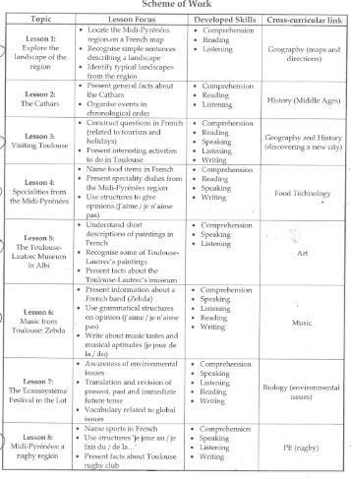
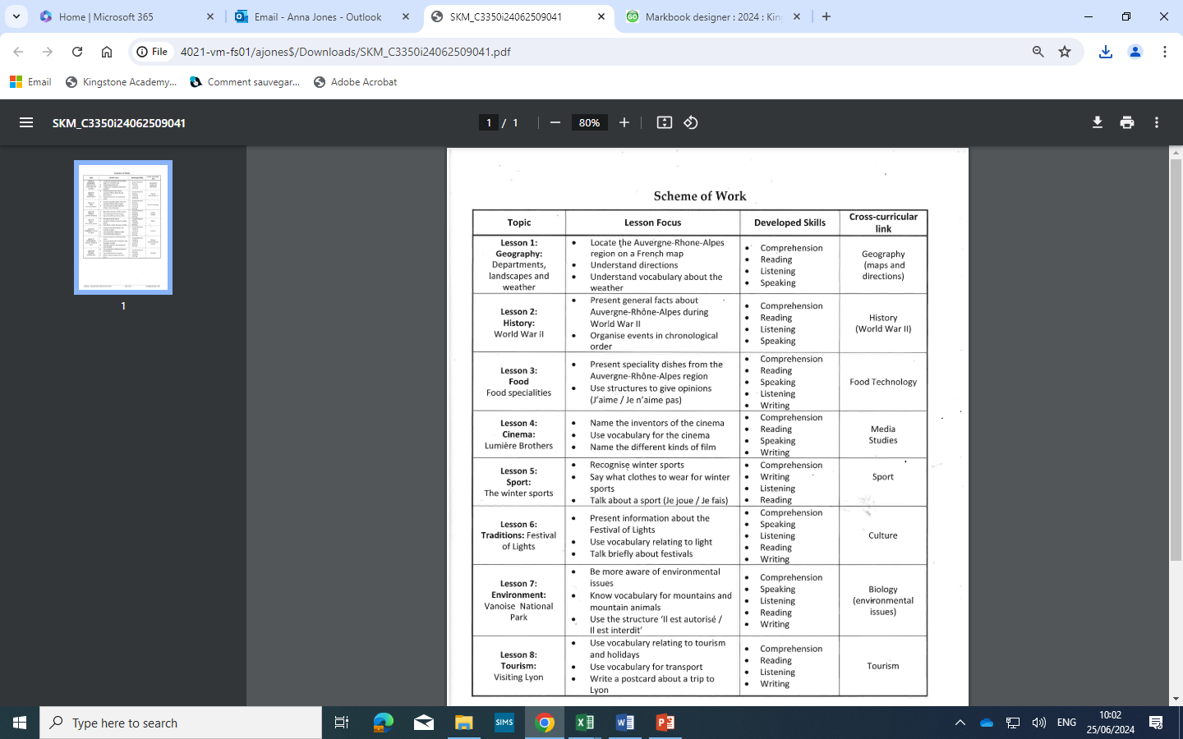
Year 9 Summer Term 1 Key knowledge Set 2 only Project based learning Focus on either do and play Exploring Midi Pyrenees Or Auvergne/Rhône Alpes | Grammar | Ssc – sound symbol correspondence | Blended learning | SMSC links
Big picture
Looking at different regions of the target language country
This fits into Theme 3 of GCSE specification the world around us to provide cross curricular learning for the students who have not chose to continue with French at GCSE
These cultural projects can be delivered in conjunction with a film study depending on curriculum time

