Slide 1
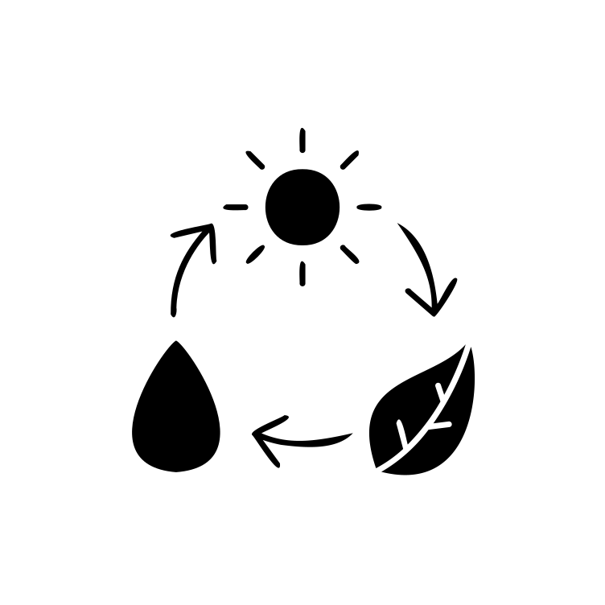
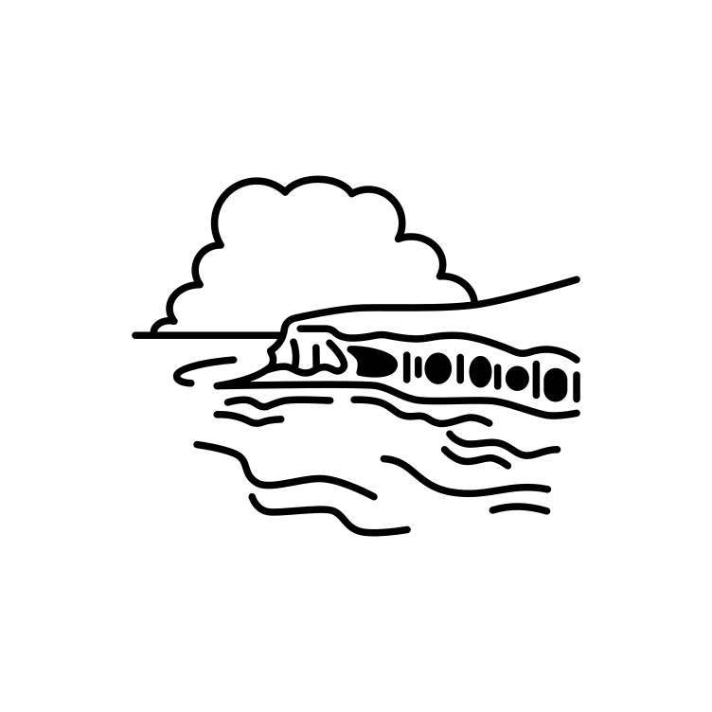
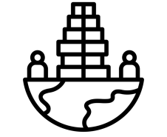
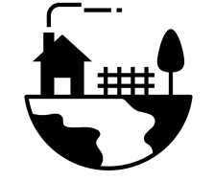
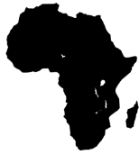
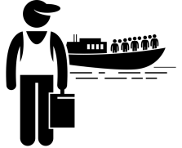
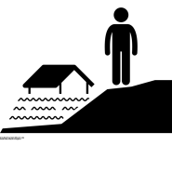
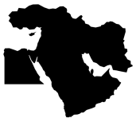
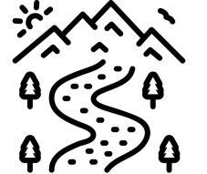
‘Achieving Success Together’
KS3
Learning Journey
A good geographer uses a range of data to enquire about:
Formation of Physical features
Development of Human features
Interconnected & Interdependent
Human & Physical Geography
Sustainability - Looking to the future (all topics)
Inequality of geography
Place, space, scale and time
Ready for KS4
Do different ecosystems face similar issues?
Rainforests and Deserts
Sustainability
Interconnection
Interdependence
Development
Inequality
How effective are people at sustainability of environments?
How can cities become more sustainable?
What impact does the sea have on our coastline?
What issues and challenges does
Rio de Janeiro face?
Y9
Why is India a country of contrasts?
Is Africa a continent in crisis?
Geopolitics
Inequality
Sustainability
Climate Change
Why does geography matter on a global scale?
Are volcanoes a blessing or a curse?
Why is the Middle East a region of inequality?
Y8
How do we manage biomes sustainably?
Why is China changing?
How has the economy changed in the UK?
How does the geography of Russia compare to the UK?
Why are rivers important in the UK?
Resources
Weather & Climate
Economy
Migration
Why does geography matter on a local scale?
Y7
Why did Hereford develop as a settlement?
What is the difference between weather and climate?
How are UK populations changing?
How does geography shape the UK?
Olivia McLachlan 2022
‘ Perseverance - Kindness - Tolerance - Respect ’

Slide 2
What does Geography involve? Geography is concerned with the formation of physical features of the earth and its atmosphere and the development of human features on the earth’s surface, with a deepening appreciation for how these aspects are interconnected. Geography considers the challenges and opportunities of interdependence of humans on their environment and their impact when looking to the future, considering sustainable management of the environment and the inequality of experiences and resources. Geographers examine the nature of people, places and the environment within a spatial context and at different scales. To help achieve this, students draw on geographical disciplinary practices as well as the integration of analyses across human and physical processes, to draw conclusions.
How do students make progress through the Geography curriculum? The Geography curriculum is carefully planned as a journey, allowing students to travel further as a foundation for a lifelong conversation, acquiring an interest and enthusiasm for the subject, challenging misconceptions and equipping them with the skills to navigate a changing world.
Y7 starts with an overview of the UK; how the spheres of geography interconnect, the UK’s natural resources and the physical processes that have shaped our island, using physical maps and aerial photographs and a local field trip to familiarise ourselves with the local geography. We move on to the population of the UK and the factors that influence their movement, including the physical features previously studied and the challenges for a sustainable future. Our third unit explores the weather and climate of the UK, both the physical processes and the impact this has on the population. With our knowledge of the physical features of the UK, the ways population moves and the local climate, we study the local city of Hereford and reasons for its development as a settlement and the challenges of human infrastructures needed in a city. Hereford grew on a river, so our next topic is to study the physical processes of rivers, such as the River Wye and how they are used by people for trade and leisure and the challenges of living near a river regarding flooding. Students will have been introduced to how the economy is based on our natural resources, trade links, and settlements throughout the year, and they now have an opportunity to study how the economy of the UK has developed over time and where we fit in on a global scale, using chocolate as a case study. We plan a field trip to Cadbury World as a case study to explore the global industry of chocolate manufacture; the primary growing conditions, containerisation, factory sites, manufacturing processes and the service industry. Additionally, a study of Bournville is a comparison with Hereford as a planned settlement. Y7 concludes with a study of Russia, which revisits the concepts explored in UK case studies to show how physical and human geographies interconnect and dictate settlement and economy in a different region.
Y8 begins with a physical geography study of tectonic activity to promote awareness of the earth as a whole, this is an applied vehicle for understanding longitude and latitude and understanding geography on a global scale. Various regions from different parts of the world are explored, using the key concepts for each and then an enquiry pertinent to that area. Geopolitics are considered as we investigate the human experience of living in each environment. China is studied as an important rising power in global geopolitics and globalised trade, linking back to the economy unit in Y7. An overview of varying biomes and why they develop links back to climate and longitude and latitude and the challenges and opportunities of the habitats they create. A study of the Middle East focuses on the developmental inequality created by exploitation of a habitat for its natural resources. A study of India considers the impact of climate on a habitat and how it impacts different people depending on various socio-economic factors. A study into Africa builds on our understanding of interconnected factors with an enquiry into the varying geopolitical, physical and cultural factors bringing growth or crisis to contrasting countries on the continent of Africa. Each study builds on factors encountered in earlier regional studies with increasing complexity.
Y9 is a transitional year into GCSE Geography. The first enquiry into coastal processes and land use provides an opportunity for fieldwork, which investigates both physical and human geography. Our focus shifts to human geography and the development of Rio De Janeiro and the challenges and opportunities of urbanisation (spiralling back to factors influencing settlement in Y7 and 8), which is followed up with an investigation into sustainable urban living in case studies in the UK, Middle East and Europe. This spirals back to investigating whether Hereford can apply innovations for sustainable living, begun in Y7. Y9 is concluded with further work on biomes introduced in Y8 at a more complex level to investigate human impact and management of tropical rainforests and hot deserts, again with a focus on sustainability.

