Slide 1
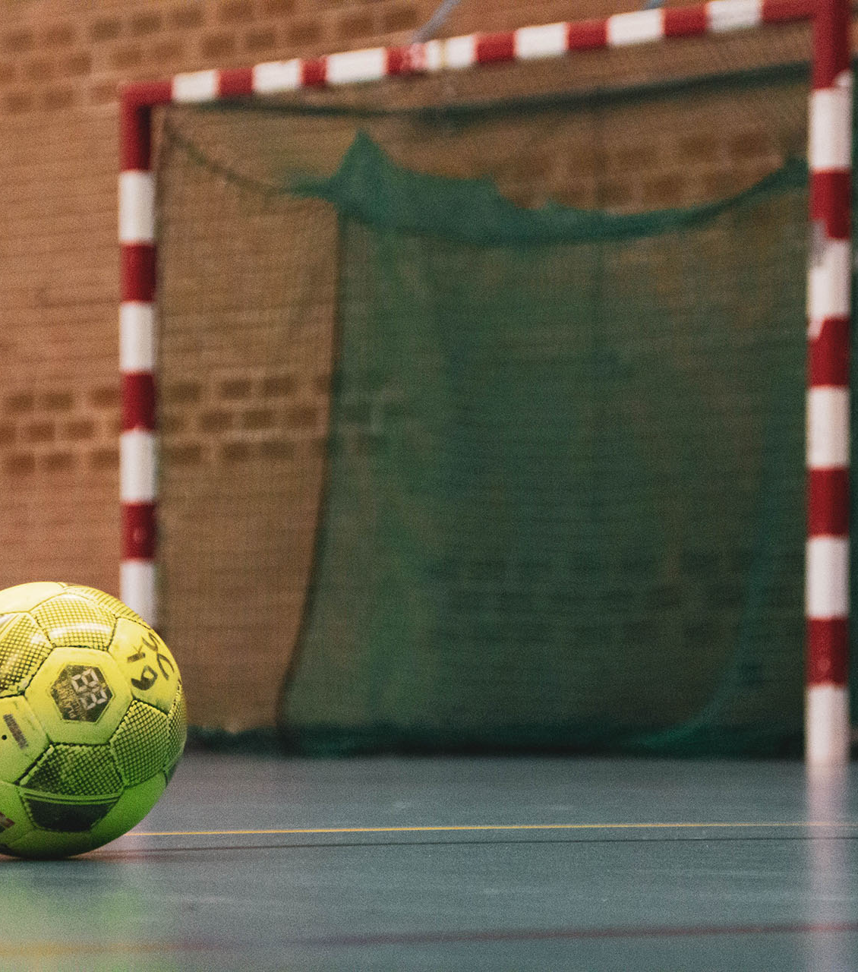
Futsal monday Lunchtime Year 7 students only ran by year 11 sports leaders

Slide 2
Tuesday lunchtime miss finch

Slide 3
Inclusive sports wednesday lunchtime mrs roberts & Mrs Harry

Slide 4
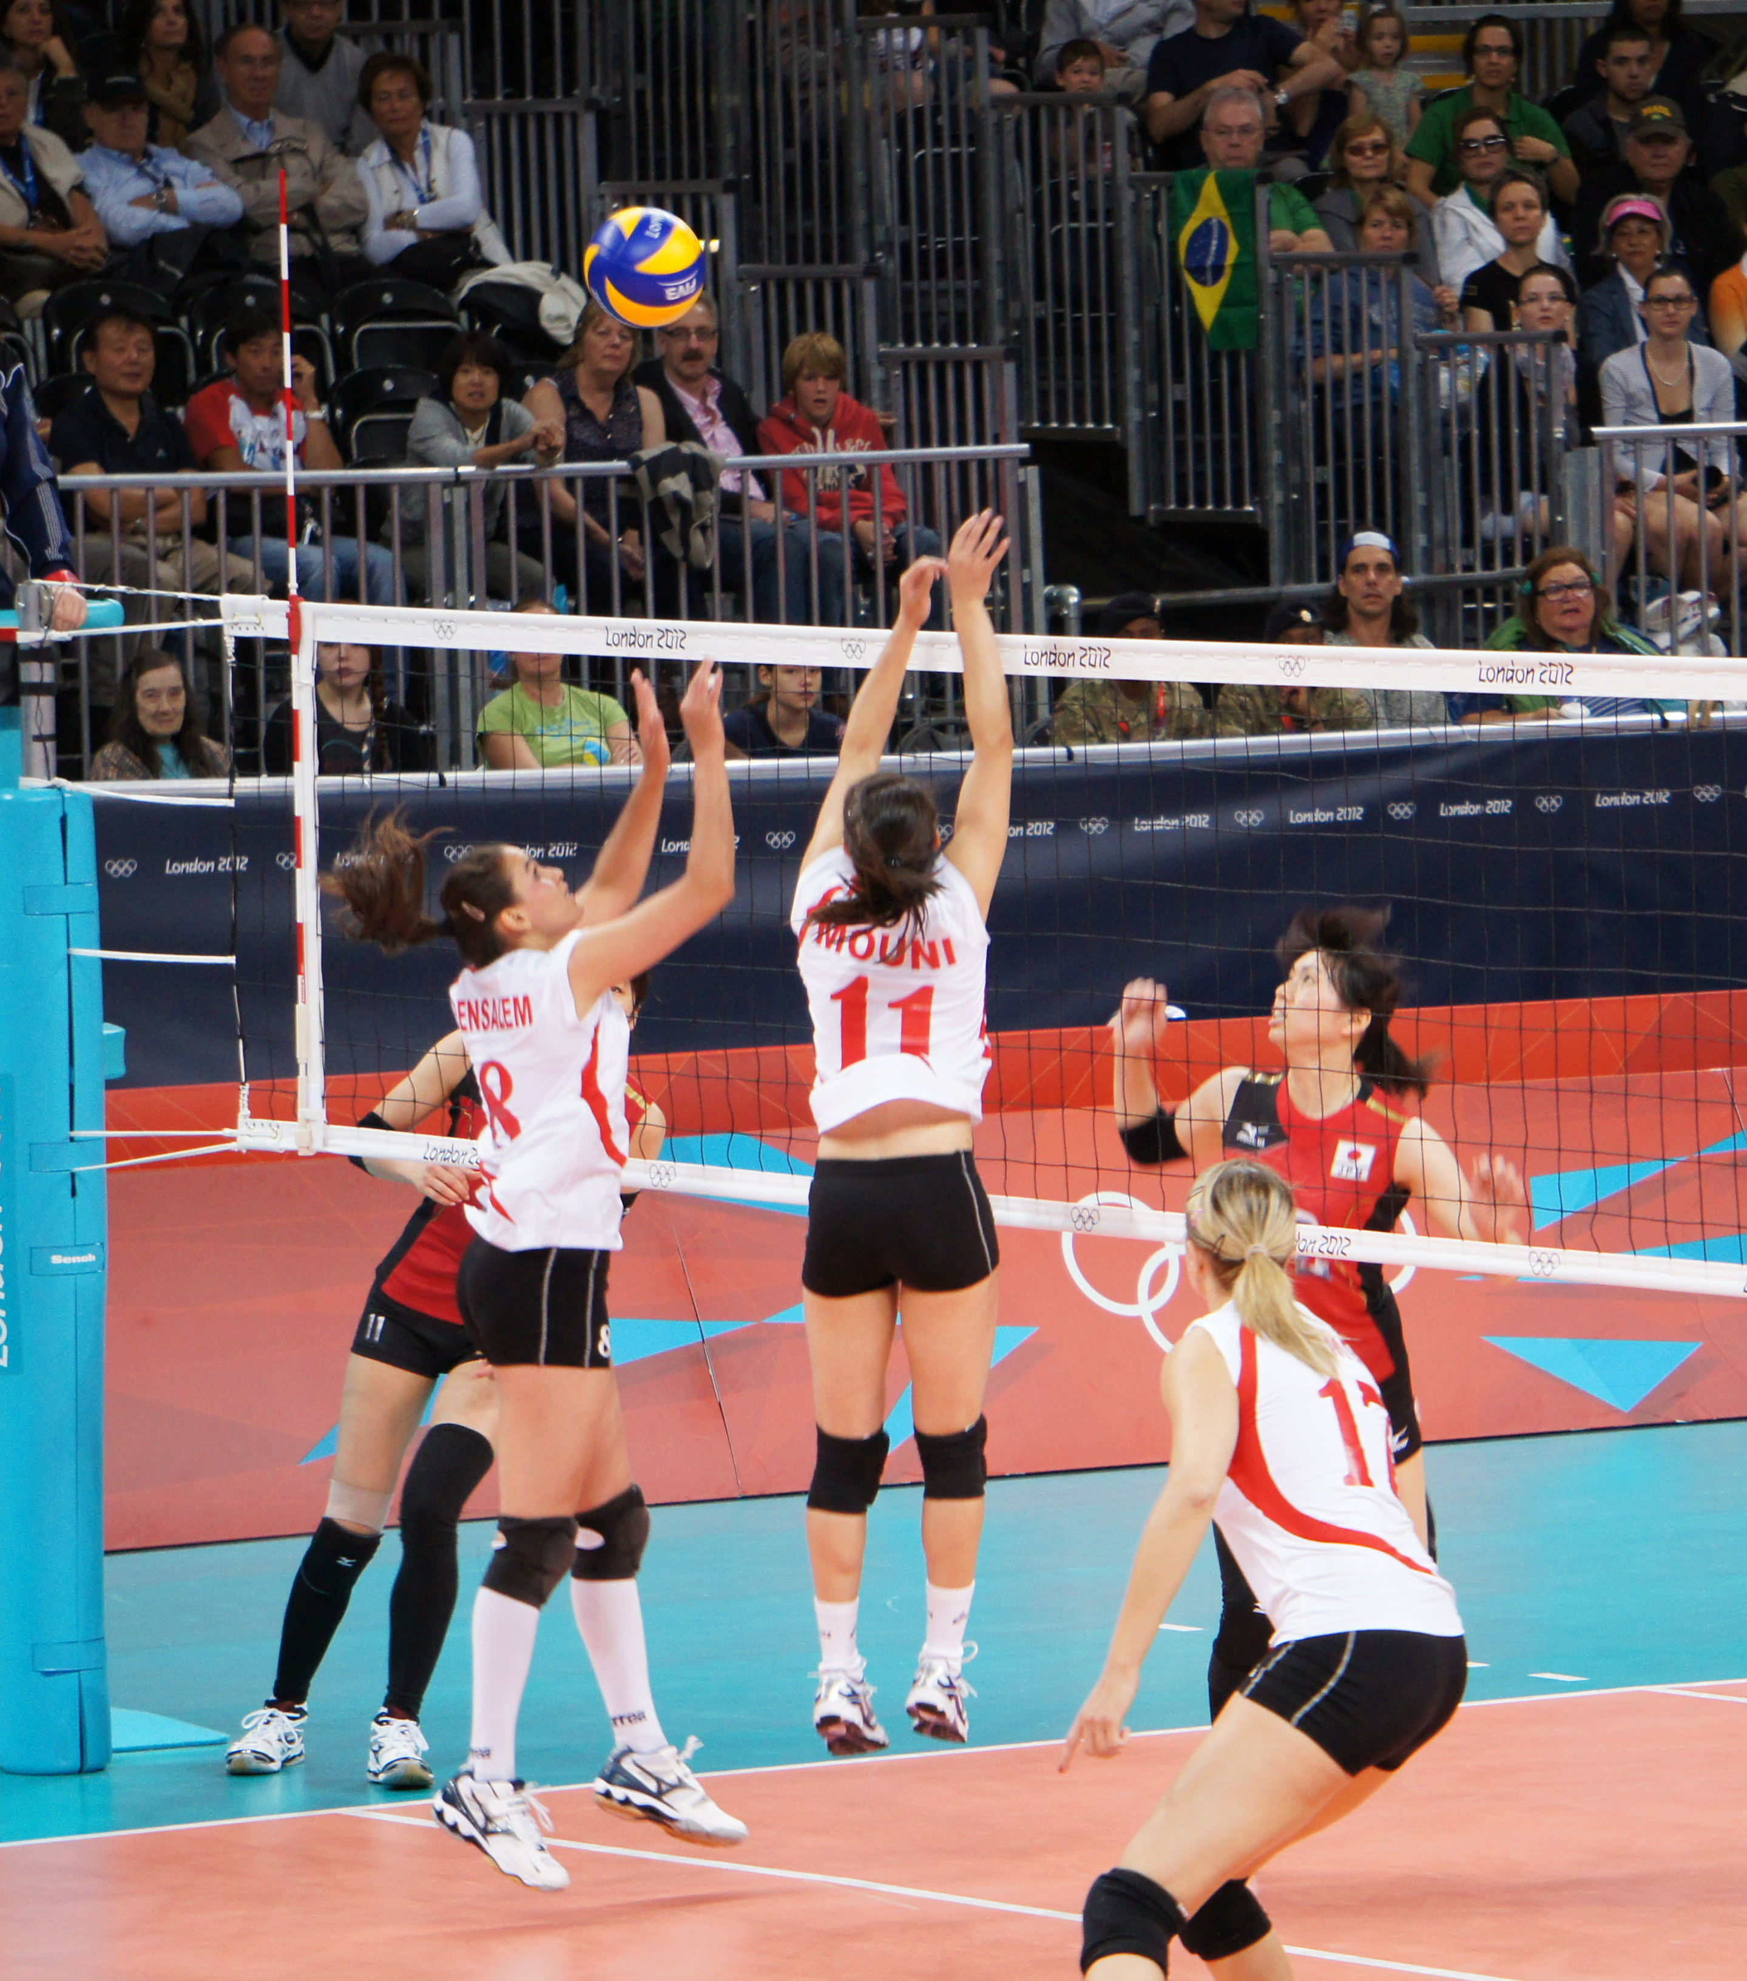
Volleyball thursday lunchtime mr bromage

Slide 5
Handball friday lunchtime mr thomas

Slide 6
Table tennis monday 3:20-4:30 gcse pe students invite only

Slide 7
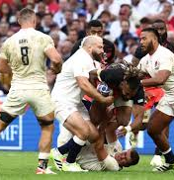
Rugby tuesday 3:20-4:20 Mr Bromage

Slide 8
Netball tuesday 3:20-4:20 miss exley

Slide 9
Girls' football wednesday 3:20-4:20 miss finch

Slide 10
Boys' football thursday 3:20-4:20 mr thomas

Slide 11
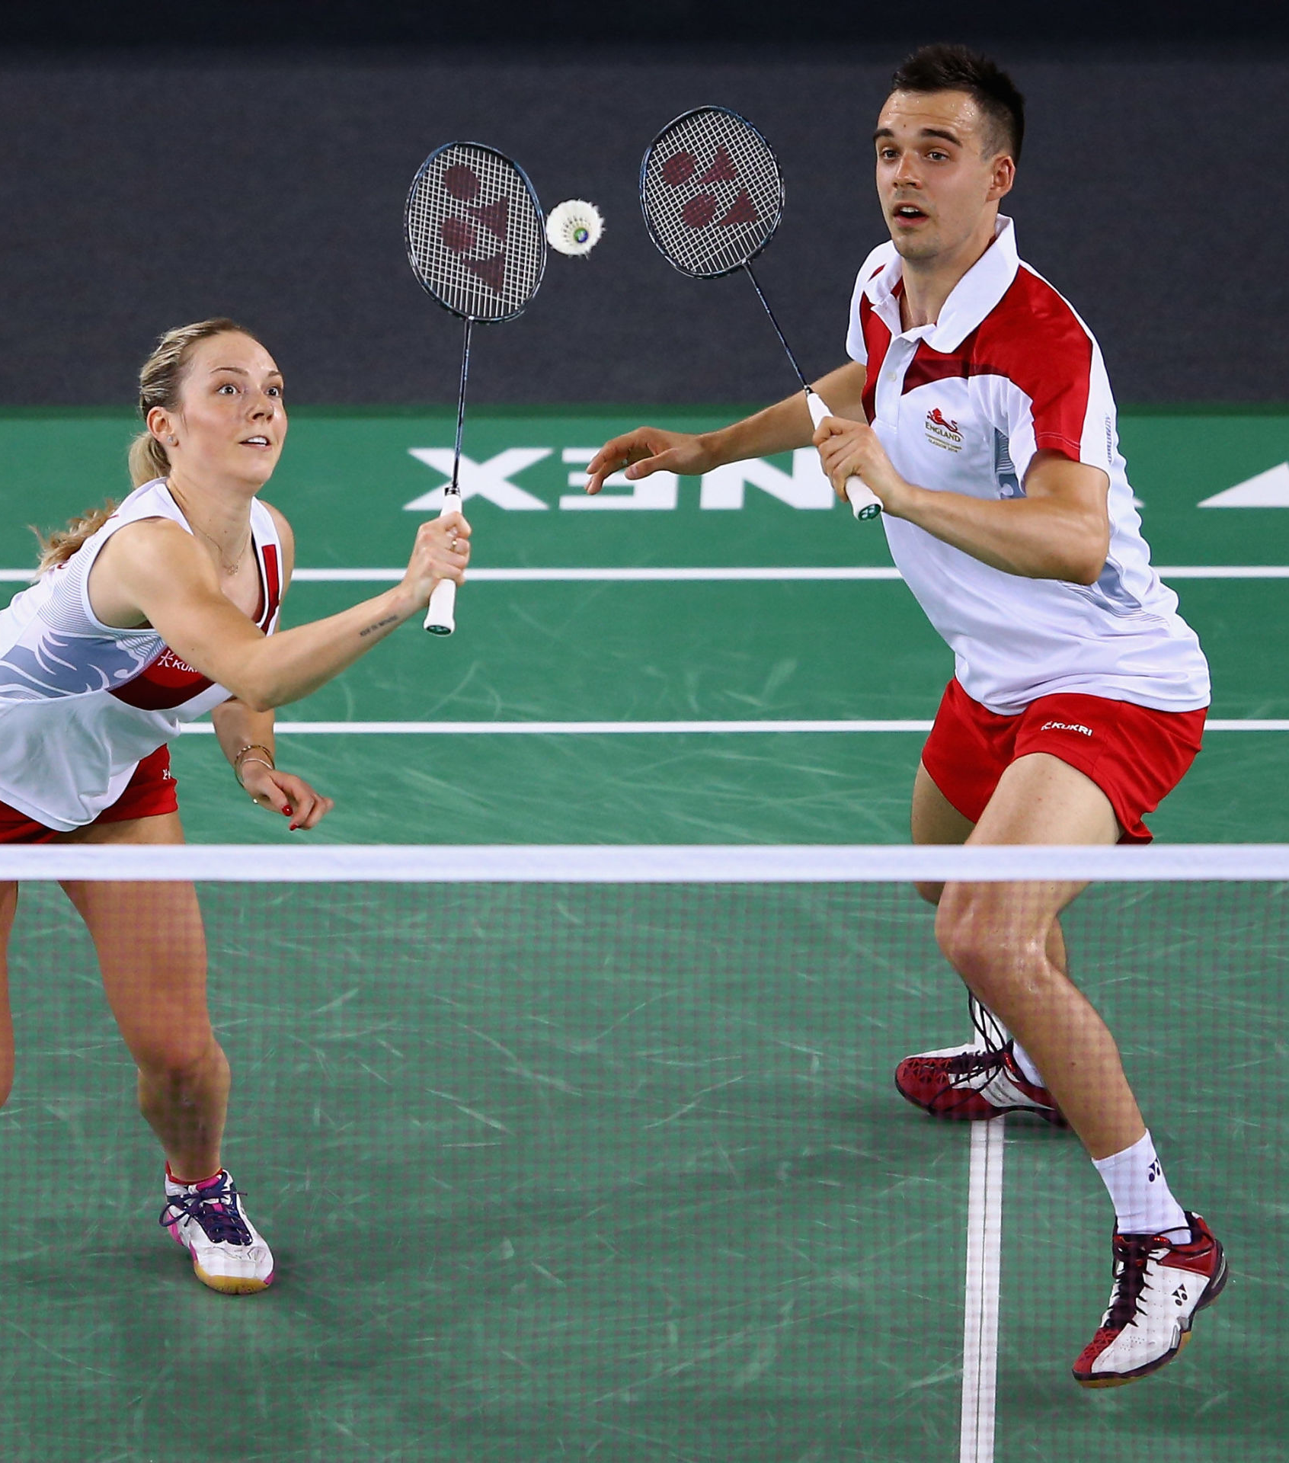
Badminton friday 3:20-4:20 mr thomas gcse pe students, invite only

